Slide 1
Sprint 1
Regression

Slide 2
Sprint 1: Regression
Task: making predictions from data
Core concepts
Algorithms and models
Implementation on real dataset
Assessing a model performance
Overfitting
Bias-variance tradeoff
K-fold cross validation
Simple regression (covered in Statistics sprint)
Gradient descent
Multiple regression
Ridge regression
Lasso regression
Wine quality dataset
Sprint 1 - Regression

Slide 3
Sprint 1: Day 1
Task: making predictions from data
Core concepts
Algorithms and models
Implementation on real dataset
Assessing a model performance
Overfitting
Bias-variance tradeoff
Simple regression (covered in Statistics sprint)
Gradient descent
Multiple regression
Wine quality dataset
Sprint 1 - Regression

Slide 4
Sprint 1: Day 2
Task: making predictions from data
Core concepts
Algorithms and models
Implementation on real dataset
Assessing a model performance
Overfitting
Bias-variance tradeoff
K-fold cross validation
Simple regression (covered in Statistics sprint)
Multiple regression
Gradient descent
Ridge regression
Lasso regression
Wine quality dataset
Sprint 1 - Regression

Slide 5
Task : making predictions from data
Sprint 3 - Retrieval

Slide 6


Task description
Predicting wine quality (red and white vinho verde wine) from various physicochemical tests
These two datasets were published in [Cortez et al., 2009] and are freely accessible at http://archive.ics.uci.edu/ml/datasets/Wine+Quality
@A. Ponsero
@V. Ponsero
Information about physicochemical property of the wine
Can I predict the wine quality score?
Sprint 1 - Regression

Slide 7
Machine learning and regression
Training dataset
x
Feature extraction
ML model
^
y
Input variables:
Wine properties
Prediction:
Predicted wine score
ML algorithm
y
Variable to predict : Wine score
Quality metric
Sprint 1 - Regression

Slide 8
Algorithm: Regression fundamentals
Sprint 3 - Retrieval

Slide 9

Regression fundamentals
Predicting wine quality (red and white vinho verde wine) from various physicochemical tests
x₁ = acidity, y₁= quality
x = input variable
y = output that needs to be predicted
x₂ = acidity, y₂= quality
y
x₃ = acidity, y₃= quality
…
x
Sprint 1 - Regression

Slide 10
Regression fundamentals
Predicting wine quality (red and white vinho verde wine) from various physicochemical tests
x₁ = acidity, y₁= quality
x = input variable
y = output that needs to be predicted
Model = expected relationship between x and y
x₂ = acidity, y₂= quality
y
f(x)=w₀ + w₁ x
x₃ = acidity, y₃= quality
with :
w₀ the interception
w₁ the slope and
ε the error
y_{i}= w₀ + w₁ x_{i} + ε_{i}
Regression coefficients
…
x
Sprint 1 - Regression

Slide 11
Fitting a line to data
There is a « cost » of using a given line
X
Sprint 1 - Regression

Slide 12
Fitting a line to data
There is a « cost » of using a given line
X
Sprint 1 - Regression

Slide 13
Fitting a line to data
There is a « cost » of using a given line
X
Sprint 1 - Regression

Slide 14
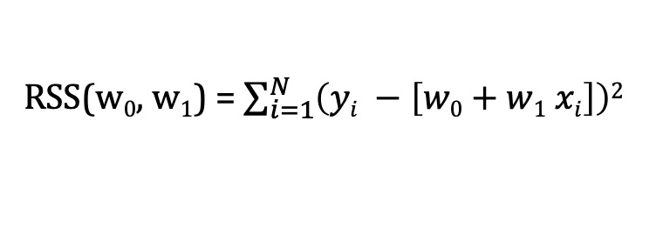
Fitting a line to data
There is a « cost » of using a given line : Residual sum of squares (RSS)
RSS(w₀, w₁) = $\sum_{i=1}^{N}{\left(yi −\left[w0+w1 xi\right]\right)2}$
The « best » line is the one minimizing the cost over w₀ and w₁
X
Sprint 1 - Regression

Slide 15
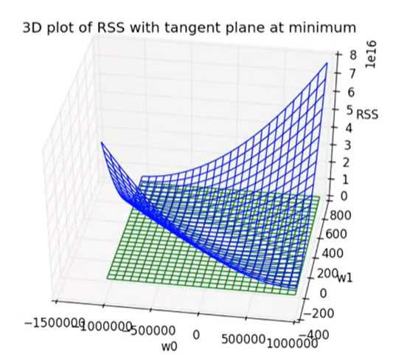
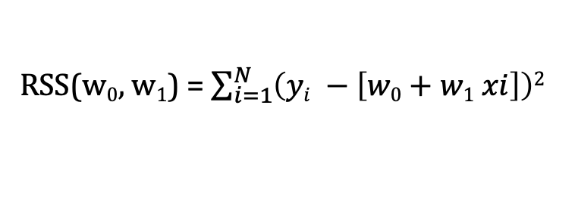
RSS optimization – Gradient descent algorithm
How to find the w₀ and w₁ that minimize the RSS ?
RSS(w₀, w₁) = $\sum_{i=1}^{N}{\left(yi −\left[w0+w1 xi\right]\right)2}$
This function is convex - > the minima is unique
@ E. Fox – ML specialization
Sprint 1 - Regression

Slide 16
RSS optimization – Gradient descent algorithm
How to find the w₀ and w₁ that minimize the RSS ?
The gradient descent algorithm allows to find the minima of RSS(w0, w1)
Applied on minimizing RSS, gradient descent algorithm is called OLS (Ordinary least squares)
@ E. Fox – ML specialization
Sprint 1 - Regression

Slide 17
Machine learning and regression
Training dataset
x
Feature extraction
ML model
^
y
Input variables:
Wine properties
Prediction:
Predicted wine score
w
ML algorithm
y
OLS
Variable to predict : Wine score
Quality metric
RSS
Sprint 1 - Regression

Slide 18
Algorithm: Polynomial regression
Sprint 3 - Retrieval

Slide 19
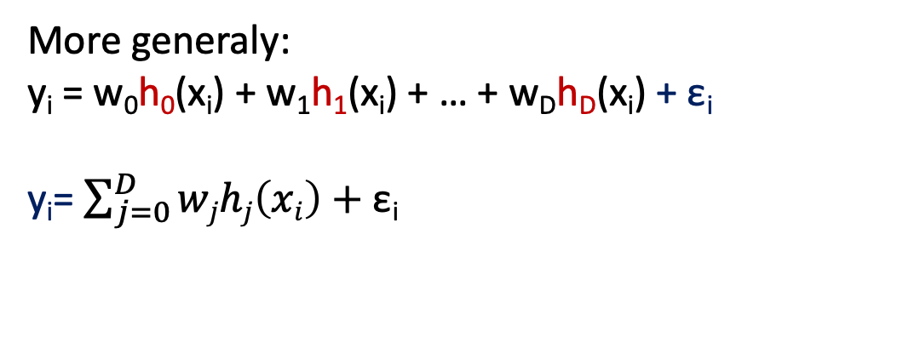
Polynomial regression
Model:
y_{i} = w₀ + w₁ x_{i} + w₂ x_{i}² + … + w_{D} x_{i}^{D} + ε_{i}
y
Treat as different features
(function of the input x)
x
In this example :
Feature 1 = 1 (const)
Feature 2 = x
Feature 3 = x²
…
Feature D+1 = x^{D}
More generaly:
y_{i} = w₀h₀(x_{i}) + w₁h₁(x_{i}) + … + w_{D}h_{D}(x_{i}) + ε_{i}
y_{i}= $\sum_{j=0}^{D}{wjhj\left(xi\right)+\text{ε}\text{i}}$
h_{j} = j^{th} feature
W_{j} = weight associated with the j^{th} feature
Sprint 1 - Regression

Slide 20
Machine learning and regression
Training dataset
x
Feature extraction
h(x)
ML model
w
ML algorithm
y
Quality metric
Sprint 1 - Regression

Slide 21
Algorithm: Multiple Linear regression
Sprint 3 - Retrieval

Slide 22
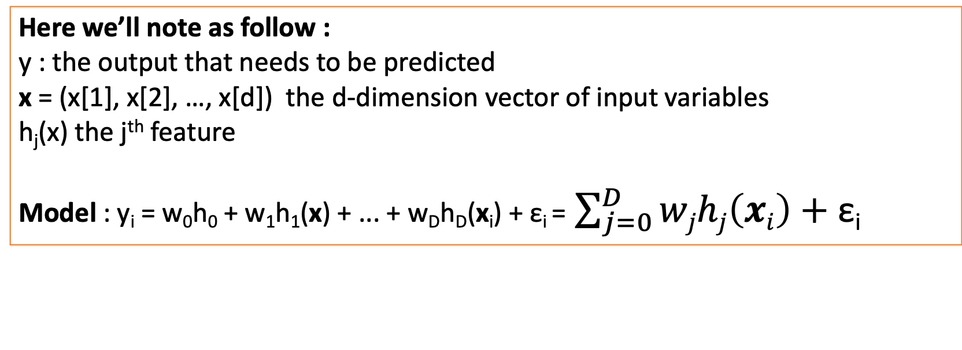
Multiple Regression
In order to improve prediction, we may need to take into account multiple input variables
x₁ = acidity, x₂=chlorides, x₃ = residual sugars …
y₁= quality
Here we’ll note as follow :
y : the output that needs to be predicted
x = (x[1], x[2], …, x[d]) the d-dimension vector of input variables
h_{j}(x) the j^{th} feature
Model : y_{i} = w₀h₀ + w₁h₁(x) + ... + w_{D}h_{D}(x_{i}) + ε_{i} = $\sum_{j=0}^{D}{wjhj\left(xi\right)+\text{ε}\text{i}}$
Similarly as simple regression, gradient descent on RSS allows to find the best fit
Sprint 1 - Regression

Slide 23
Concepts: Assessing the performances of the model
“All models are wrong. The practical question is : how wrong do they have to be to not be useful”.
George Box
Sprint 3 - Retrieval

Slide 24
Measuring loss
Loss function:
L(y, f_{w}(x))
What is the cost of using the parameters w to predict y?
actual value
Predicted value
Examples:
Absolute error: L(y, f_{w}(x))) = |y – f_{w}(x)|
Squared error: L (y, f_{w}(x))) = (y – f_{w}(x))²
Sprint 1 - Regression

Slide 25
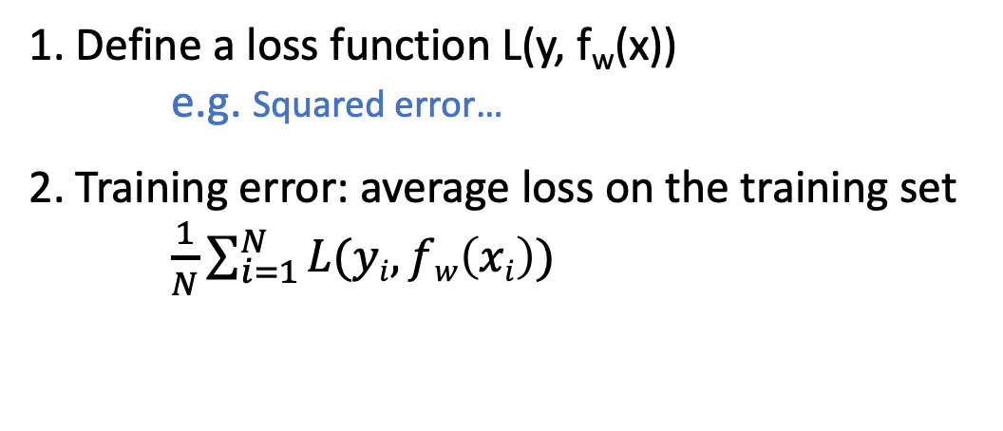
Training error
y
f(x)=w₀ + w₁ x
1. Define a loss function L(y, f_{w}(x))
e.g. Squared error…
2. Training error: average loss on the training set
$\frac{1}{N}\sum_{i=1}^{N}{L(yi, fw\left(xi\right))}$
x
Sprint 1 - Regression

Slide 26
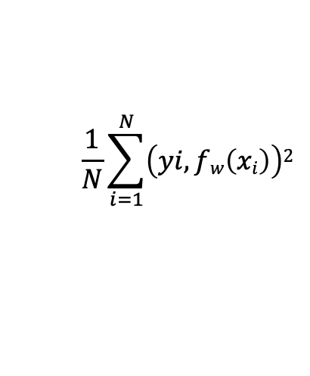
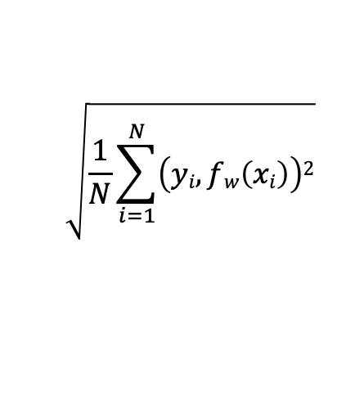
Training error
y
f(x)=w₀ + w₁ x
1. Define a loss function L(y, f_{w}(x))
e.g. Squared error…
2. Training error: average loss on the training set
$\frac{1}{N}\sum_{i=1}^{N}{L(yi, fw\left(xi\right))}$
x
$$\frac{1}{N}\sum_{i=1}^{N}{\left(yi, fw\left(xi\right)\right)2}$$
Using the squared loss:
$$\sqrt{\frac{1}{N}\sum_{i=1}^{N}{\left(yi, fw\left(xi\right)\right)2}}$$
RMSE:
Sprint 1 - Regression

Slide 27
Is Training error a good measure of performance?
Simple linear model
Very complex model
y
y
x
x
High training error
Very low training error
Issue: Training error is overly optimistic because the parameters were fit to the training data
Usually small training error ≠ good prediction!
Sprint 1 - Regression

Slide 28
Test error
How can we approximate the generalization error?
We can compute the error on a set of data NOT included on the training set.
Train
Training set
Model
Assess
Test set
Original dataset
Sprint 1 - Regression

Slide 29
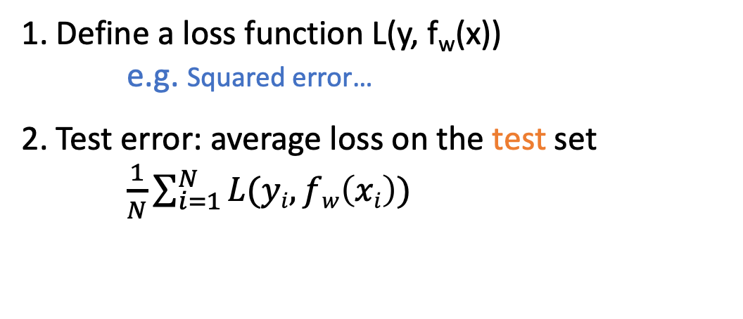
Test error
y
f(x)=w₀ + w₁ x
1. Define a loss function L(y, f_{w}(x))
e.g. Squared error…
2. Test error: average loss on the test set
$\frac{1}{N}\sum_{i=1}^{N}{L(yi, fw\left(xi\right))}$
x
$$\frac{1}{N}\sum_{i=1}^{N}{\left(yi, fw\left(xi\right)\right)2}$$
Using the squared loss:
$$\sqrt{\frac{1}{N}\sum_{i=1}^{N}{\left(yi, fw\left(xi\right)\right)2}}$$
RMSE:
Sprint 1 - Regression

Slide 30
Overfitting?
Test error
Overfitting if:
There exist a model with estimated parameters w’ such that:
Training error (w) < training error (w’)
Test error (w) > test error (w’)
Error
Training error
Model complexity
Sprint 1 - Regression

Slide 31
Implementation: Predicting wine quality
Sprint 3 - Retrieval

Slide 32
Task description
Compute a simple and multiple regression to predict the wine quality
-> Open Jupyter notebook in Cyverse
@A. Ponsero
@V. Ponsero
Information about physicochemical property of the wine
Can I predict the wine quality score?
Sprint 1 - Regression

Slide 33
Additional slides

Slide 34
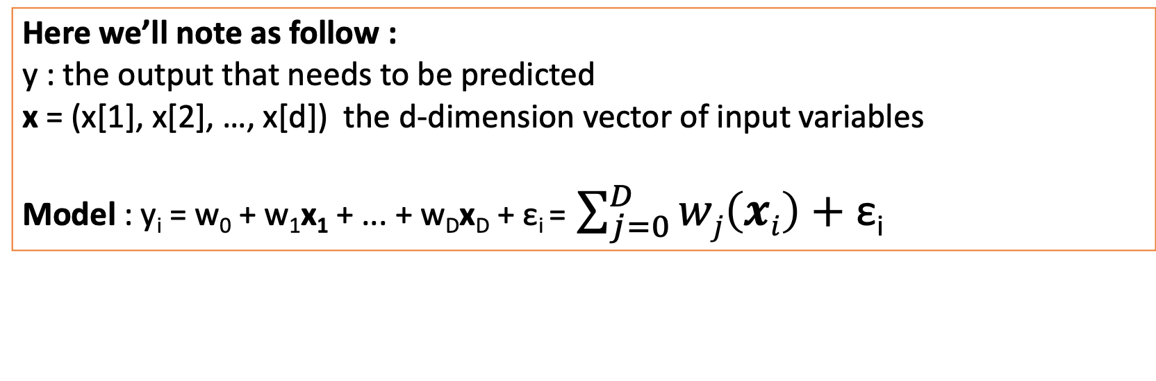
Multiple Linear Regression
In order to improve prediction, we may need to take into account multiple input variables
x₁ = acidity, x₂=chlorides, x₃ = residual sugars …
y₁= quality
Here we’ll note as follow :
y : the output that needs to be predicted
x = (x[1], x[2], …, x[d]) the d-dimension vector of input variables
Model : y_{i} = w₀ + w₁x₁ + ... + w_{D}x_{D} + ε_{i} = $\sum_{j=0}^{D}{wj\left(xi\right)+\text{ε}\text{i}}$
Similarly as simple regression, gradient descent on RSS allows to find the best fit
Sprint 1 - Regression

